Slide 1


Case Study: Statistical Analysis With Python
By Irdam Elba Septian

Slide 2
TABLE OF CONTENTS
INTRODUCTION
01
04
STATISTICAL ANALYSIS : CHI-SQUARE
GOOGLE COLABORATORY
02
05
STATISTICAL ANALYSIS : LINEAR REGRESSION
STATISTICAL ANALYSIS : CORRELATION
03
06
CONCLUSION

Slide 3
INTRODUCTION
Hello! My name is Irdam Elba Septian and I am a student in Business Intelligence batch 12 at dibimbing.id. In this slides I’m about to share my mini project with you. I’ll be using tools such as Google Colab to do statistical analysis in Python

Slide 4
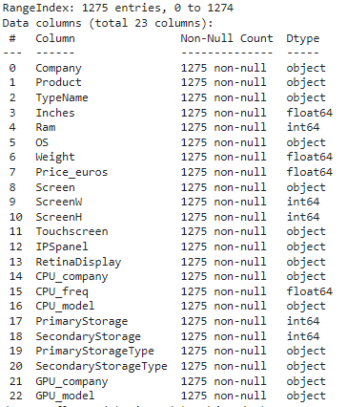
INTRODUCTION
In this example, I will be using a laptop price dataset to perform correlation, chi-square tests, and linear regression.
As shown in the image, the dataset contains 23 columns and 1,275 rows.
If you’d like to learn more about the dataset, you can visit here
If you also like to look at the full coding of this project, you can also visit here

Slide 5

What is a Google Colaboratory?
Google Colaboratory is a cloud-based platform that allows users to write and execute Python code directly in their web browser. It provides an environment for machine learning, data analysis, and other computational tasks, offering free access to GPUs and TPUs.
Google Colab is widely used for collaborative coding, especially for data science and artificial intelligence projects, as it enables users to share and execute notebooks seamlessly.

Slide 6
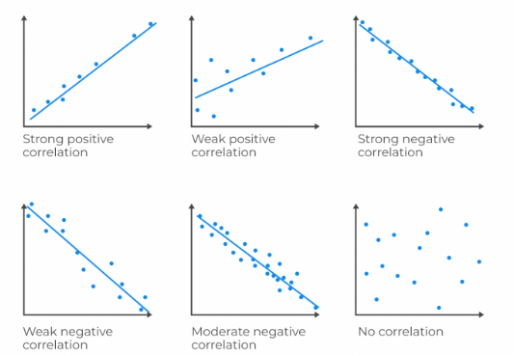
What is a Correlation?
Correlation is a statistical measure that describes the strength and direction of a relationship between two variables.
It tells you how closely two variables move together. If two variables are correlated, changes in one variable tend to be associated with changes in the other.
As shown in the image, correlation can be positive or negative.

Slide 7
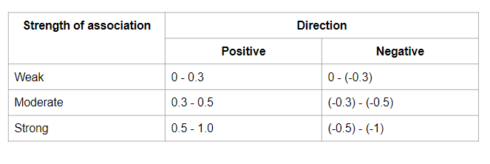
What is a Correlation?
In correlation analysis, there is correlation coefficient, which a statistical measure that indicates the strength and direction of a relationship between two variables.
It ranges from -1 to +1: a value of +1 means there's a perfect positive relationship, -1 means a perfect negative relationship, and 0 means no relationship at all. But in correlation analysis, there is rarely a perfect relationship between columns. That is why, as shown in the image, the relationship is divided into three category.

Slide 8
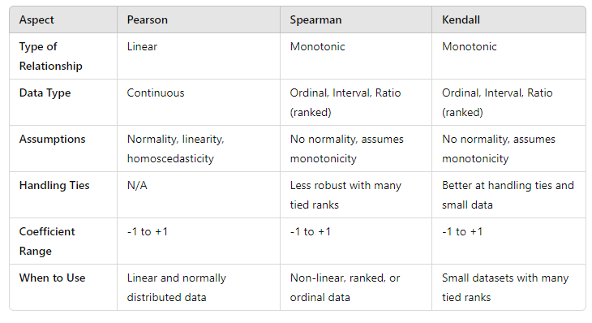
What is a Correlation?
There are different types of correlation, in this project I will use three different correlation which is pearson, kendall and spearman.
The difference is shown in the image.

Slide 9
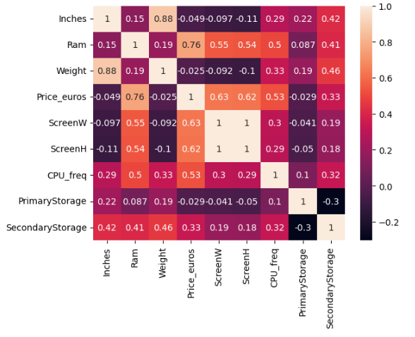
STATISTICAL ANALYSIS : CORRELATION
In Python, you can use one of its function (df.corr()) to calculate correlation. This will automatically calculate correlation between all numerical columns.
As shown in the image is the correlation among numerical columns.
In this section, what I want to target is the Price_euros column. as you can see, the column that has highest correlation with Price_euros is Ram with 0.76. This means the relationship between to columns is strongly positive

Slide 10
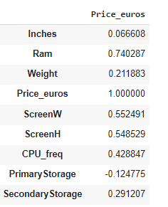
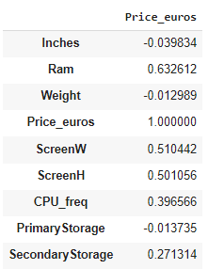
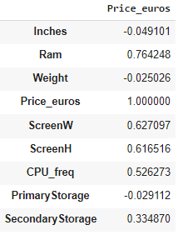
STATISTICAL ANALYSIS : CORRELATION
In the previous column, I have decided to use spearman correlation to visualize the correlation. Because as shown in the image, it create stronger correlation.
Pearson
Kendall
Spearman

Slide 11
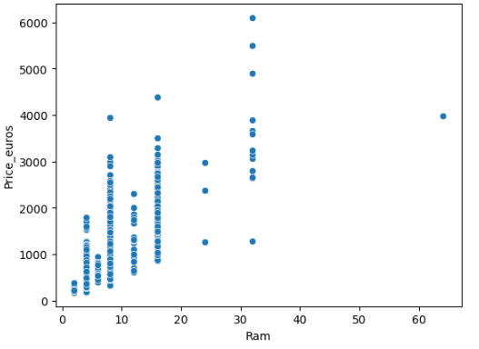
STATISTICAL ANALYSIS : CORRELATION
We can also visualize the relationship between columns using a scatterplot in Python, although it's still important to use the correlation function for a more precise analysis.
As shown in the image, we can see that every time Ram increases, Price increases as well.

Slide 12
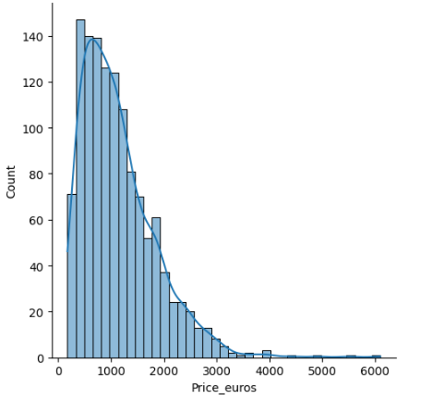
STATISTICAL ANALYSIS : CORRELATION
Another example of why I used spearman is because of the dataset. In this data set, a lot of the data is not normal distributed as shown in the image.
Spearman is better with skewed data, because it assesses the relationship between variables based on their ranks rather than their actual values.

Slide 13
CONCLUSION : CORRELATION
In this dataset, the column with the highest correlation to Price_euros is Ram, with a correlation coefficient of 0.76.
The correlation between the two columns is strongly positive, meaning that as one increases, the other increases as well.
In this dataset, I used Spearman correlation because the data has a skewed distribution, and Spearman is better suited for capturing stronger relationships in such cases.

Slide 14
What is Chi-square?
Chi-square test is a statistical method used to determine if there is a significant association between categorical variables.
The Chi-Squared test is used to test whether two categorical variables have a relationship.
It can also be said that the Chi-Squared Test is a correlation for categorical variables.

Slide 15
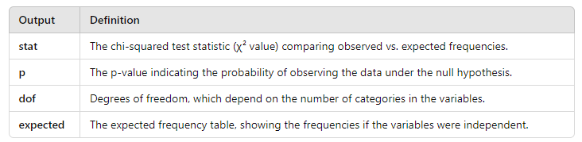
STATISTICAL ANALYSIS : CHI-SQUARE
In Python, you can use one of its function (stat, p, dof, expected = chi2_contingency(df_chi)) to perform chi-square test. This will automatically calculate the p, stat, dof, and expected.
For the definition, you can see the image.

Slide 16
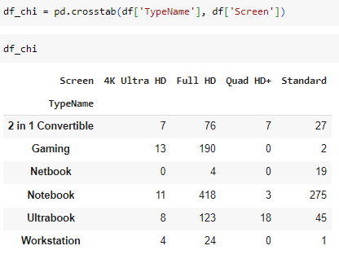
STATISTICAL ANALYSIS : CHI-SQUARE
The dataset being used here is still laptop prices, but this time we will focus on categorical columns. The columns we are using are TypeName and screen.
TypeName refers to the different types or categories of laptops in this dataset, while screen represents the quality or specifications of the laptop's display.
To perform a chi-square test, we first need to group the columns and count the unique values in the data. In order to do this you can use pivot table or crosstab function, as shown in the image.

Slide 17
STATISTICAL ANALYSIS : CHI-SQUARE
When performing a chi-square test, we typically begin by defining the hypothesis, as this is what we aim to determine in the first place.
The hypothesis used in this case are
H0 = There is no relationship between the laptop TypeName and screen quality.
H1 = There is a relationship between the laptop TypeName and screen quality
Using Python, I can easily apply the aforementioned function to calculate the statistic and test the hypothesis.

Slide 18
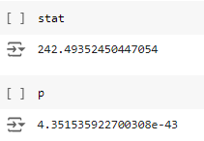
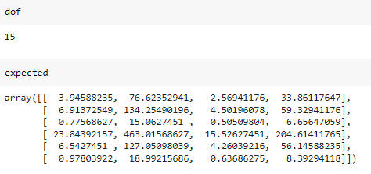
STATISTICAL ANALYSIS : CHI-SQUARE
After I calculated the statistics using Python, I get the result as shown in the image

Slide 19
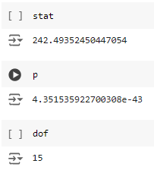
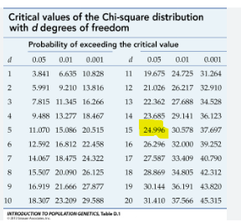
STATISTICAL ANALYSIS : CHI-SQUARE
To understand the result, we first need to look at the degrees of freedom (dof), which is 15. Next, we decide on the alpha level, which is 0.05. The critical value we get is 24.996, and the test statistic we obtained is significantly higher than the critical value.
We can also observe the p-value, which is smaller than the chosen alpha level of 0.05.

Slide 20
CONCLUSION : CHI-SQUARE
Based on the chi-square test results, it is safe to conclude that the null hypothesis H0 is rejected, indicating that there is a relationship between the laptop TypeName and screen quality. This conclusion is supported by the fact that the test statistic is greater than the critical value, and the p-value is smaller than the alpha level.

Slide 21
What is Linear Regression?
Statistical method used to model the relationship between a dependent variable and one or more independent variables.
The goal is to find the best-fitting straight line (called the regression line) that predicts the dependent variable based on the independent variable(s).
In simple linear regression, there is only one independent variable, while in multiple linear regression, there are multiple independent variables.
Linear regression helps in understanding how changes in independent variables affect the dependent variable, making it useful for forecasting, trend analysis, and determining relationships between variables.

Slide 22
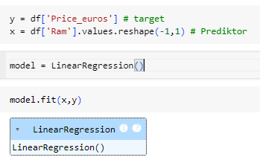
STATISTICAL ANALYSIS : LINEAR REGRESSION
In Python, you can use one of its function to perform linear regression. This can be done first by dividing the column into different variables, then call the LinearRegression function into model variables and then we let Python calculate the coefficient and intercept value with model.fit(x,y).
In this case we use the columns that has the highest correlation, which is Price_euros as the target and Ram as the predictor.

Slide 23
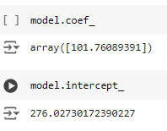
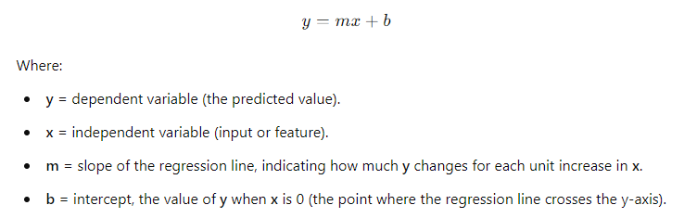
STATISTICAL ANALYSIS : LINEAR REGRESSION
The result from the calculations are as shown in the image
Now we can use the formula to calculate the linear regression

Slide 24
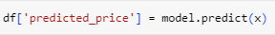
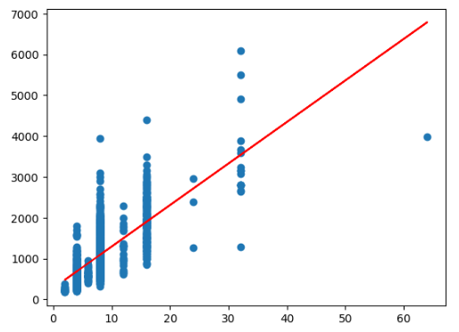
STATISTICAL ANALYSIS : LINEAR REGRESSION
Python also can automatically call the function into new column with
We can also visualize the relationship and the regression line like shown in the image

Slide 25
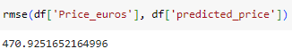
STATISTICAL ANALYSIS : LINEAR REGRESSION
Now to tell if the model is good or not, we need to calculate the Root Mean Squared Error. It measures the average magnitude of the error between the predicted values and the actual values.
Python able to do that as well like shown in the image
As shown in the image, the rmse is 470.9251652164996
For data ranging between 500-6000 euros, an RMSE of 400 is too large to ignore.

Slide 26
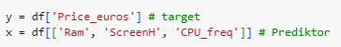
STATISTICAL ANALYSIS : LINEAR REGRESSION
Since the rmse is too large, I’d like to use more columns as the predictor in order to decrease the rmse
As shown in the image, the next columns used as predictors are ScreenH and CPU_freq, as they have the highest correlation with the target variable after Ram.

Slide 27
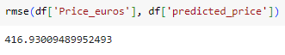
STATISTICAL ANALYSIS : LINEAR REGRESSION
As shown in the image, the rmse is still too large, even though it is decreased.
So we can conclude that linear regression is not suitable for use with this data.

Slide 28
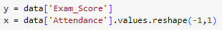
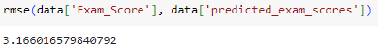
STATISTICAL ANALYSIS : LINEAR REGRESSION
Now, what does a good linear regression model look like? For this explanation, I will use a different dataset called StudentPerformanceFactors. In short, this dataset focuses on students' final scores and includes multiple elements that may influence their performance.
I used exam_Score as target and Attendance as predictor because these two columns have the highest value with 0.67
As you can see, the rmse between the real value and expected value only 3.17.
On the data ranging 50-100, I think this model is accepted with this dataset.

Slide 29
CONCLUSION : LINEAR REGRESSION
Based on the test results, the laptop_price dataset is not suitable for linear regression if the goal is to make predictions. This could be due to factors such as the presence of too many outliers, multicollinearity, and other issues. This dataset could maybe use other regression model such as Lasso, Ridge, or Random Forest Regression.
The other dataset (StudentsPerformanceFactors) have better result, maybe because the dataset is suitable to use with linear regression because it doesn’t have the problem that mentioned above.

Slide 30
THANK YOU

